Slide 1

Stealth port scan Detection using snort
By
Hari Priya aalla
Muthyam G Reddy

Slide 2
Contents
Introduction
Types of port scans
Tools
Stealth port scans
Proposed Methodology
Detecting Stealth port scan attacks
Conclusion

Slide 3
Introduction
Port scanning is a reconnaissance phase in the planning of cyber-attacks.
It is observed that 50% of attacks against cyber systems are preceded by some form of network scanning activity.

Slide 4
Types of TCP flags
SYN
ACK
FIN
PSH
RST
URG
Types of port scans
Non stealth port scan
Stealth port scan

Slide 5
Tools used for scanning and detection
Snort
It is an open source network based intrusion detection and prevention system.
It has ability to perform real time traffic analysis and packet logging
Nmap
It is an open source network scanner
It is used for port scanning and OS detection

Slide 6
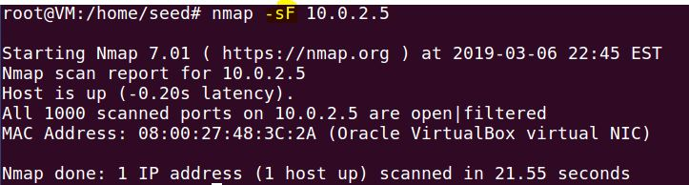
Fin scan
In FIN Scan send the packets with FIN flag set. If the port is open we don’t get any response. If the port is closed, we get RST packet.

Slide 7
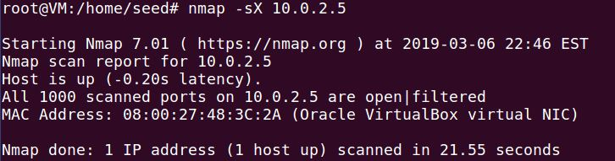
XMAS scan
In XMAS scan we send the packets with FIN, URG and PSH flags set. If the port is closed we get RST packet. If the port is open we don’t get any response.

Slide 8
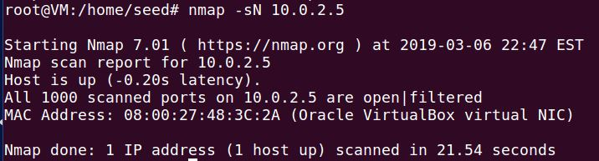
Null scan
In NULL scan we sent TCP packet with no flag set.

Slide 9
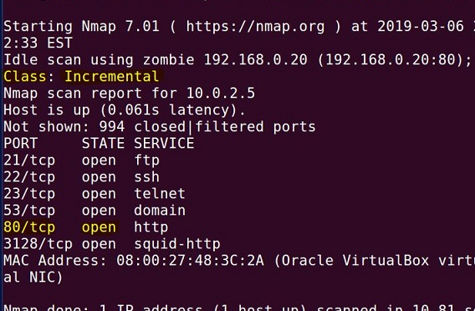
Idle port scan
Idle port scanning uses spoofed IP address and sends the SYN packets to the target to find whether the target is open or closed, By using the IP ID number.

Slide 10
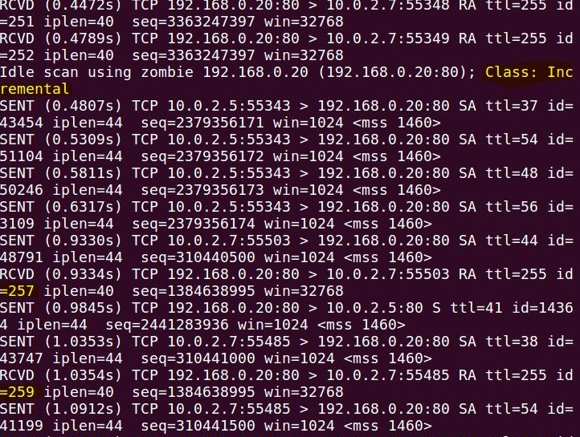

Slide 11
Snort rules for detecting port scans
Alert
alert tcp $EXTERNAL_NET any <> $HOME_NET any (msg:”FIN SCAN DETECTED”; flags:F; sid:1000001)
Alert
alert tcp $EXTERNAL_NET any <> $HOME_NET any (msg:”XMAS SCAN DETECTED”; flags:FPU; sid:1000002)
Alert
alert tcp $EXTERNAL_NET any <> $HOME_NET any (msg:”NULL SCAN DETECTED”; flags:0 ;sid:1000003
Alert
alert tcp $EXTERNAL_NET any <> $HOME_NET any (msg:”Idle scan detected”; flags:S; exist-ipid)

Slide 12
Proposed methodology for idle scan
Packet capturing and pre-processing phase
Analysis and detection phase

Slide 13
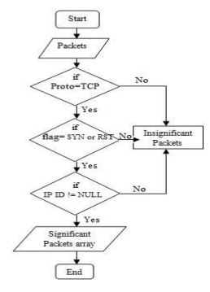
Packet capturing and pre-processing phase
In this phase the technique will identify the significant packet for analysis and detection phase of the idle scan attack

Slide 14
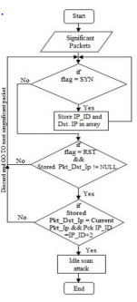
Analysis and detection phase
In this phase we will analyze the significant packet and check whether idle scan attack detected or not

Slide 15
Conclusion
Thus, using snort rules and Detection Algorithm we successfully detected Stealth port scan attacks.
In the proposed technique we have used the IP ID number to detect Idle port scan attack which is a part of IPv4 header of TCP/IP. In future, we can detect idle port scan attack in IPv6 header which does not use IP ID field.

Slide 16
Thank you

Slide 17
Reference
A. Mishal, A. Roshni, S. Azman, and N. M. Kussay, “Quantum Grover Attack on the Simplified- AES,” Malaysia, pp. 204-211, February 2018.
P. W. Shor, “Polynomial-Time Algorithms for Prime Factorization and Discrete Logarithms on a Quantum Computer,” SIAM Journal on Computing, no. 5, p. 1484.
J. Markoff. (2010) Quantum Computing Reaches for True Power. New York Times. (Accessed 3 January, 2011). [Online]. Available: http://www.nytimes.com/2010/11/09/science/09compute.html

